Slide 1
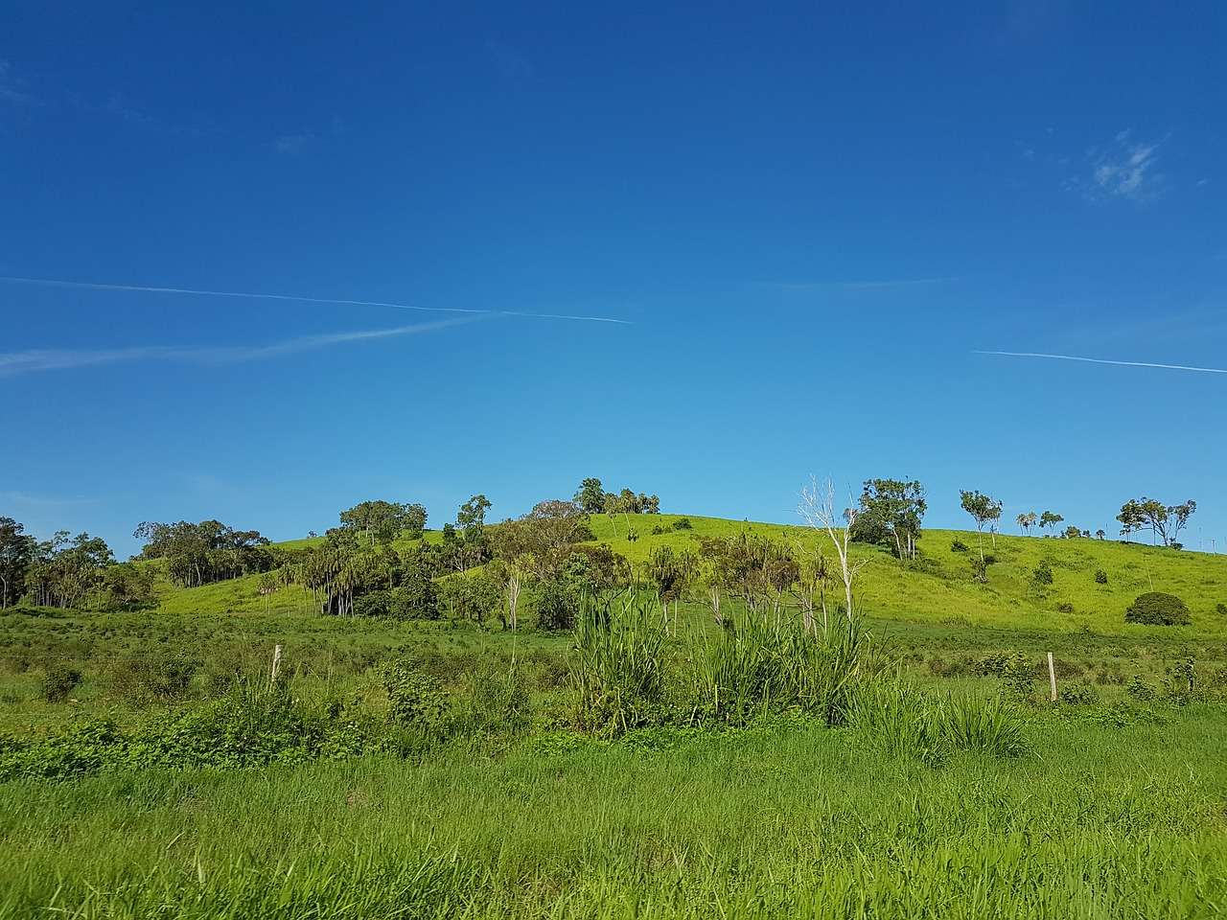
INDIGENOUS LAND MANAGEMENT
We will explain how Aboriginal and Torres Strait Islander peoples' land management practices have informed contemporary biodiversity protection.
Notes:
Insert cover image and use transparency settings to fade image.

Slide 2
Do not delete this slide.
This slide is designed so that you can copy the prompt box you need and insert it into your slides.
This slide is hidden and will not be included when presenting your lesson.
TRACK WITH ME
VOCABULARY
1 -
HINT
Students, remember….
CHECK FOR UNDERSTANDING
READ WITH ME
TEACHER CUE
MAKE THE CONNECTION
Students, you already know….
EXTENSION

Slide 3
Put the levels of classification in order using numbers 1 - 7.
NUMBER | A: Peacock | B: Emu | C: Cassowary
1 | S: Pavo cristatus | K: Animalia | O: Casuariiformes
2 | P: Chordata | F: Casuariidae | G: Casuarius
3 | K: Animalia | G: Dromaius | C: Aves
4 | O: Galliformes | O: Casuariiformes | S: Casuarius casuarius
5 | C: Aves | C: Aves | F: Casuariidae
6 | G: Pava | P: Chordata | K: Animalia
7 | F: Phasianida | S: Dromaius novaehollandiaes | P: Chordata
HINT
King KINGDOM Phillip PHYLUM Came CLASS Over ORDER For FAMILY Good GENUS Spaghetti SPECIES

Slide 4
Repeat the opposite word/phrase.
ORGANISM
LIVING THING

Slide 5
Repeat the opposite word/phrase.
HABITAT
WHERE AN ORGANISM LIVES

Slide 6
Repeat the opposite word/phrase.
FOOD CHAIN
SHOWS TRANSFER OF ENERGY BETWEEN ORGANISMS

Slide 7
Repeat the opposite word/phrase.
FOOD WEB
SHOWS TRANSFER OF ENERGY WITHIN ECOSYSTEMS

Slide 8
Repeat the opposite word/phrase.
INDEPENDENT VARIABLE
WHAT IS CHANGED IN THE EXPERIMENT

Slide 9
Repeat the opposite word/phrase.
DEPENDENT VARIABLE
WHAT IS MEASURED AND CHANGES

Slide 10
Repeat the opposite word/phrase.
CONTROLLED VARIABLE
WHAT ARE KEPT THE SAME

Slide 11
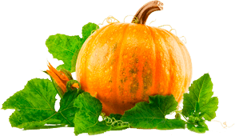
In this experiment, students wanted to see if pumpkin plants grow quicker in full sun not shade.
At the end of 4 weeks the pumpkin plants were measured in cm using a ruler.
One your whiteboards write:
What the independent variable is?
What the dependent variable is?
What would be two controlled variables?
1.
2.

Slide 12
Match the correct observable feature to the most suitable group.
Number | Observable feature | Groups (A-E)
1 | Wings Feathers Beak
2 | Fur Hair Mammary glands
3 | Dry scales Hard shell
4 | Wet skin Soft skin
5 | Wet scales Boney skin
A)Amphibian
B)Reptile
C)Mammal
D) Bird
E) Fish and rays

Slide 13
We will explain how Aboriginal and Torres Strait Islander peoples' land management practices have informed contemporary biodiversity protection.
TRACK WITH ME
READ WITH ME
We will describe examples of Aboriginal and Torres Strait Islander peoples' land management practices.
We will explain how these practices have informed contemporary land management.
DECLARE THE OBJECTIVE
Read the learning objective to your partner.
Notes:
Learning Objectives contain concepts (nouns, big ideas), skills (verbs, measurable behaviours) and sometimes context (restricting or targeting conditions).
●Example: Students will be able to describe the concept of density and apply it to floating and sinking.
●
Success criteria are specific measurable outcomes that if met mean that the student has met the learning objective.
Examples:
•Students will be able to compare densities of substances using mass and volume.
•Students will be able to identify whether a solid or liquid will float or sink in a liquid based on their densities.

Slide 14
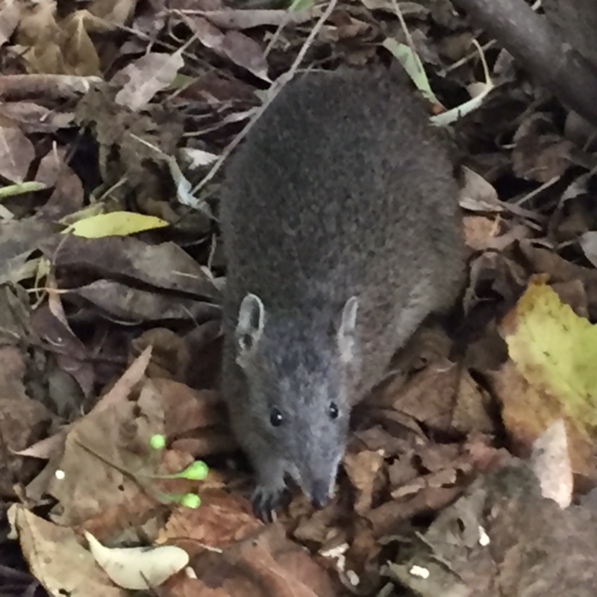
We will explain how Aboriginal and Torres Strait Islander peoples' land management practices have informed contemporary biodiversity protection.
Aboriginal and Torres Strait Islander people are very knowledgeable about our country, plants and animals.
They manage the ecosystem with fire stick farming in a very effective way. This benefits plant growth and leads to animal population increases.
What are some other things that can help protect plant and animal life?
MAKE THE CONNECTION
Students, you already know that today that we still use fire stick farming methods to help clear the land.

Slide 15
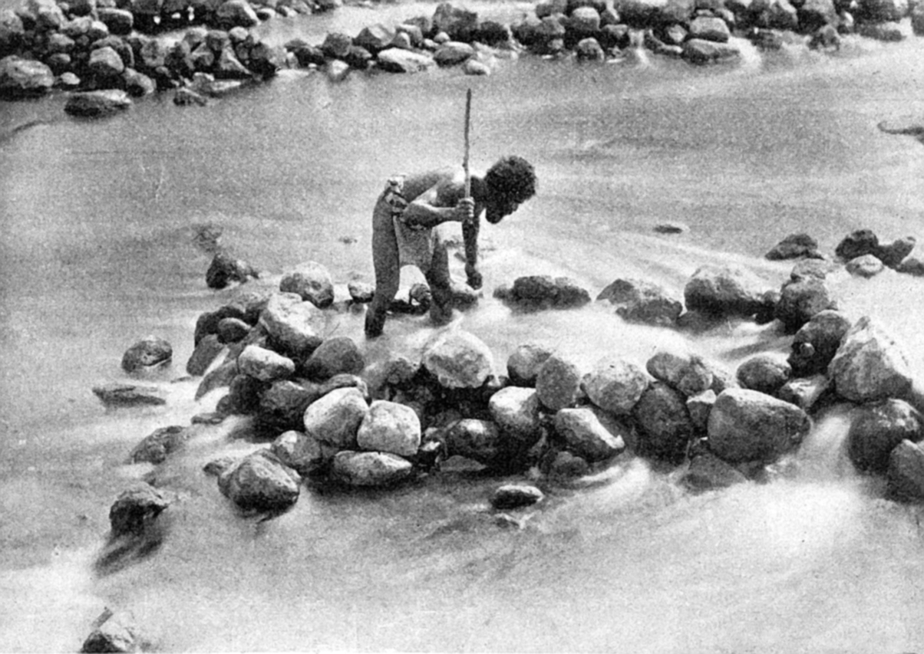
We will explain how Aboriginal and Torres Strait Islander peoples' land management practices have informed contemporary biodiversity protection.
For over 50,000 years, Australia’s Indigenous communities have cared for country by using land management that worked with the environment.
Using traditional burning, fishing traps, and sowing and storing plants, they were able to create a system that was sustainable and supplied them with the food they needed.
When Europeans arrived, they brought farming practices suited to an environment very different to Australia, that in the long-term caused erosion₁ and salinity₂ .
CHECK FOR UNDERSTANDING
Why do you think the Europeans farming caused erosion and salinity?
VOCABULARY
1- movement 2 - amount of salt in soil

Slide 16
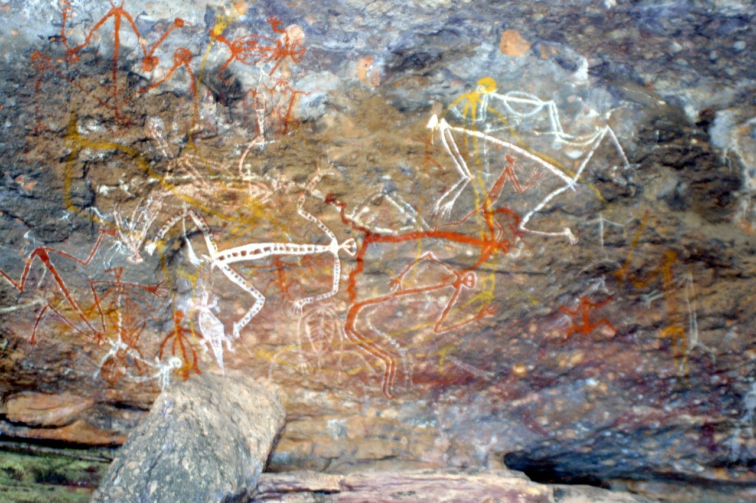
We will explain how Aboriginal and Torres Strait Islander peoples' land management practices have informed contemporary biodiversity protection.
Traditional Aboriginal land management included:
Eating a variety of food to make sure nothing became extinct.
Hunting bird eggs, leaving some behind to ensure the population would continue.
Moving around each Noongar season to make sure the land had time to regrow.
Fire stick farming.
Indigenous Australians used these land management practices to help protect biodiversity₁.
CHECK FOR UNDERSTANDING
Why would Indigenous Australians move to a different area at the change of each season?
VOCABULARY
1-variety of all living things.

Slide 17
We will explain how Aboriginal and Torres Strait Islander peoples' land management practices have informed contemporary biodiversity protection.
CHECK FOR UNDERSTANDING
Why would the government work in partnership with Indigenous Australians?
Indigenous Asutralians often work in partnership with government departments and other non-Aboriginal organisations to conserve and care for land. In such mutual relationships traditional owners and rangers perform a multitude of tasks. Some included are:
Record sites of resource use and special features
Create seasonal harvest calendars
Hunt for feral animals which threaten the delicate ecosystem of the bush.
Track endangered species and return threatened species to their native habitat.
Record (new) plants and remove seeds and weeds including invasive pests.
Manage controlled burns and set fire breaks(fire stick farming)
Conduct fisheries surveillance and compliance patrols.
Notes:
Source: Aboriginal land management & care - Creative Spirits, retrieved from https://www.creativespirits.info/aboriginalculture/land/aboriginal-land-care

Slide 18
We will explain how Aboriginal and Torres Strait Islander peoples' land management practices have informed contemporary biodiversity protection.
Land management practices today | How it was informed by Aboriginal land management.
Record sites of resource use and special features. | Know the land and were able to create a system that was sustainable and supplied them with the food they needed.
Track endangered species and return threatened species to their native habitat. | Know how to track animals and hunted and ate variety of plants and animal so none became extinct.
Manage controlled burns and set fire breaks(fire stick farming) | For over 50,000 years, Australia’s Indigenous communities cared for country Boodja/Booja by using fire Karla to manage plant growth and animal populations.
Create seasonal harvest calendars. | Aborignal people know the land and what plants grow best each season.

Slide 19
We will explain how Aboriginal and Torres Strait Islander peoples' land management practices have informed contemporary biodiversity protection.
HINT
How it was informed by Aboriginal land management. Know the land and were able to create a system that was sustainable and supplied them with the food they needed. Know how to track animals and hunted and ate variety of plants and animal so none became extinct. For over 50,000 years, Australia’s Indigenous communities cared for country Boodja/Booja by using fire Karla to manage plant growth and animal populations. Aborignal people know the land and what plants grow best each season.
Complete the table below.
Land management practices today | How it was informed by Aboriginal land management.
Record sites of resource use and special features.
Track endangered species and return threatened species to their native habitat.
Manage controlled burns and set fire breaks(fire stick farming)
Create seasonal harvest calendars

Slide 20
We will explain how Aboriginal and Torres Strait Islander peoples' land management practices have informed contemporary biodiversity protection.
CHECK FOR UNDERSTANDING
Why is it important to have protection acts in place?
There are many laws and conservation acts in place to help protect the land. On 1 January 2019, the Biodiversity Conservation Act 2016 and Biodiversity Conservation Regulations 2018 replaced both the Wildlife Conservation Act 1950 and the Sandalwood Act 1929 and their associated regulations.
These acts were built on information and knowledge of the land from idigenous Australians that had been passed down for generations. It is important that we care for our land so it is sustainable for a long time.

Slide 21
We will explain how Aboriginal and Torres Strait Islander peoples' land management practices have informed contemporary biodiversity protection.
For over 50,000 years, Australia’s Indigenous community cared for country by using land management that worked with the environment. Using traditional burning, fishing traps, and sowing and storing plants, they were able to create a system that was sustainable and supplied them with the food they needed.
Today, the government works with the Aboriginal people to help sustain life and protect biodiversity₁.
CHECK FOR UNDERSTANDING
What happened to the land when Europeans first settled?
VOCABULARY
1-variety of all living things.

Slide 22
We will explain how Aboriginal and Torres Strait Islander peoples' land management practices have informed contemporary biodiversity protection.
Land management practices today | How it was informed by Aboriginal land management.
Record sites of resource use and special features. | Know the land and were able to create a system that was sustainable and supplied them with the food they needed.
Track endangered species and return threatened species to their native habitat. | Know how to track animals and hunted and ate variety of plants and animal so none became extinct.
Manage controlled burns and set fire breaks(fire stick farming) | For over 50,000 years, Australia’s Indigenous communities cared for country Boodja/Booja by using fire Karla to manage plant growth and animal populations.
Create seasonal harvest calendars. | Aborignal people know the land and what plants grow best each season.

Slide 23
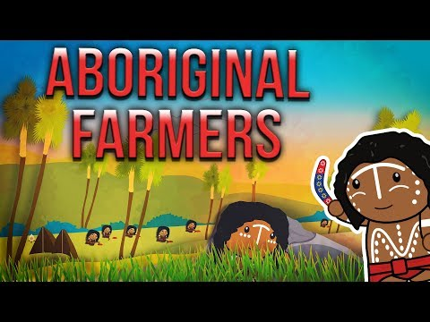
We will explain how Aboriginal and Torres Strait Islander peoples' land management practices have informed contemporary biodiversity protection.
CHECK FOR UNDERSTANDING
Notes:
Please include tasks/questions here rather than just referring to a worksheet. This will save on photocopying and facilitate sharing with other schools.
Try and build tasks/questions which escalate through Bloom’s Taxonomy. This will help with differentiation.

Slide 24
We will explain how Aboriginal and Torres Strait Islander peoples' land management practices have informed contemporary biodiversity protection.
Answer the following questions in your workbook.
What are 3 Aboriginal land management practices?
What are 3 Land management practices today, and how have they been influenced by Aboriginal practices?
Why is biodiversity important?
Notes:
Please include tasks/questions here rather than just referring to a worksheet. This will save on photocopying and facilitate sharing with other schools.
Try and build tasks/questions which escalate through Bloom’s Taxonomy. This will help with differentiation.

Slide 25
We will explain how Aboriginal and Torres Strait Islander peoples' land management practices have informed contemporary biodiversity protection.
We will describe examples of Aboriginal and Torres Strait Islander peoples' land management practices.
We will explain how these practices have informed contemporary land management.
DEFINITION
CHECK FOR UNDERSTANDING
Check Success Criteria.

